Slide 1
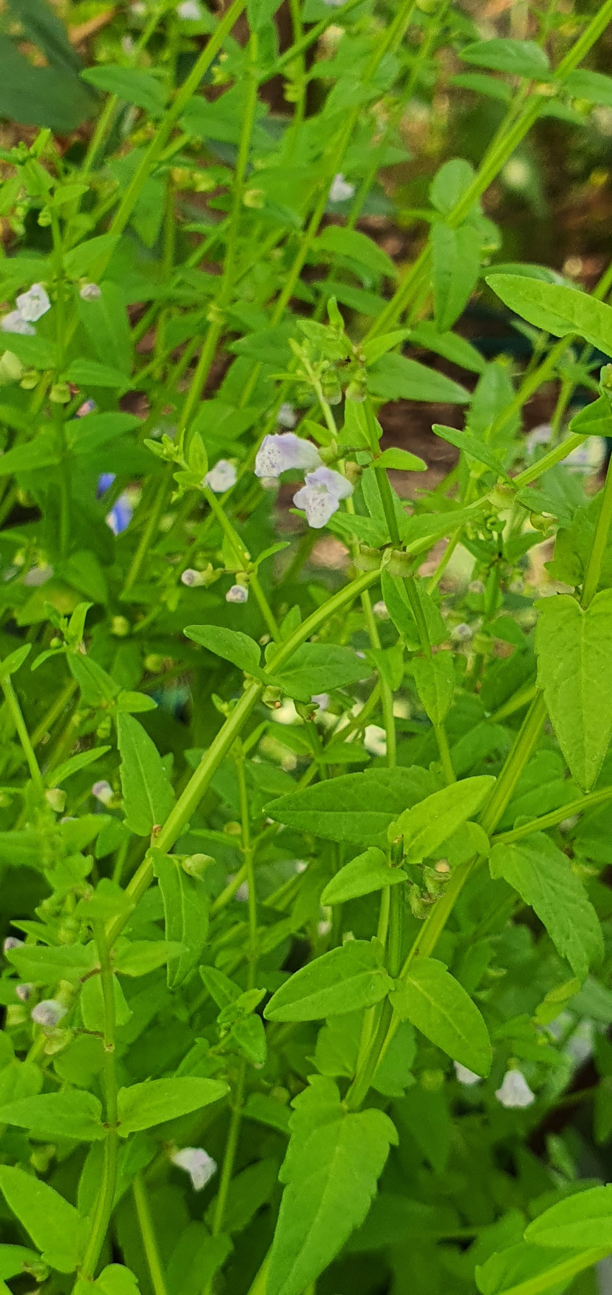
An analysis of phytochemical diversity in Scutellaria to identify species with medicinal potential
Bryce Askey¹, Yeong Hun Song¹, Yoonkyung Lee², Ru Dai¹, Tong Geon Lee^{1,3,4}, Sangtae Kim², and Jeongim Kim^{1,3}
¹Horticultural Sciences Department, University of Florida, Gainesville, FL, USA
²Department of Biology, Sungshin Women’s University, Seoul, Republic of Korea
³Plant Molecular and Cellular Biology Graduate Program, University of Florida, Gainesville, FL, USA
⁴Gulf Coast Research and Education Center, University of Florida, Wimauma, FL, USA
Scutellaria dependens

Slide 2
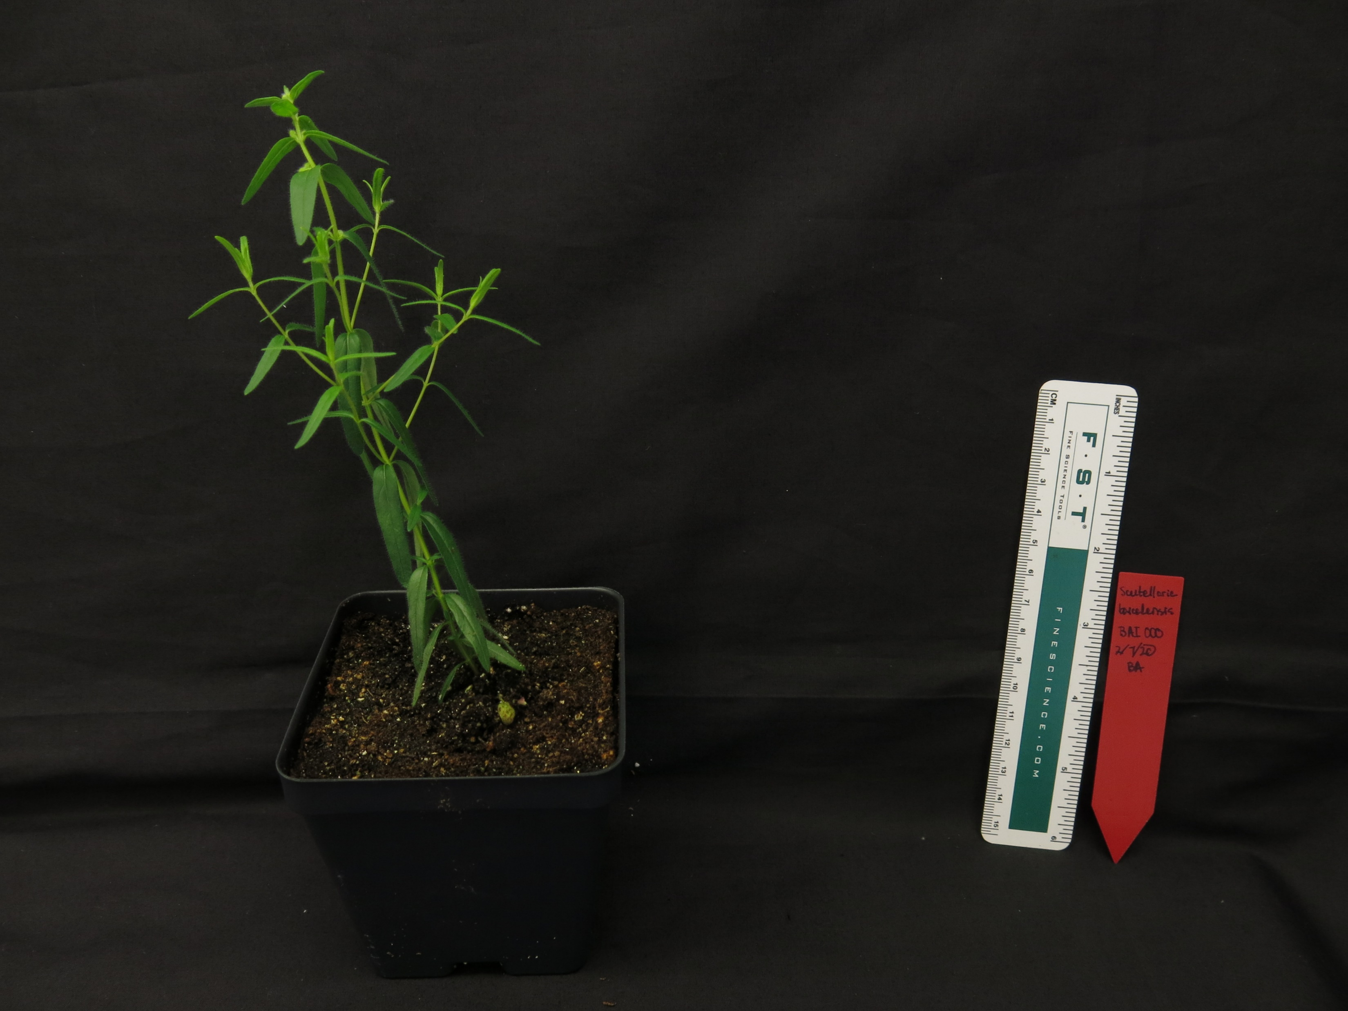
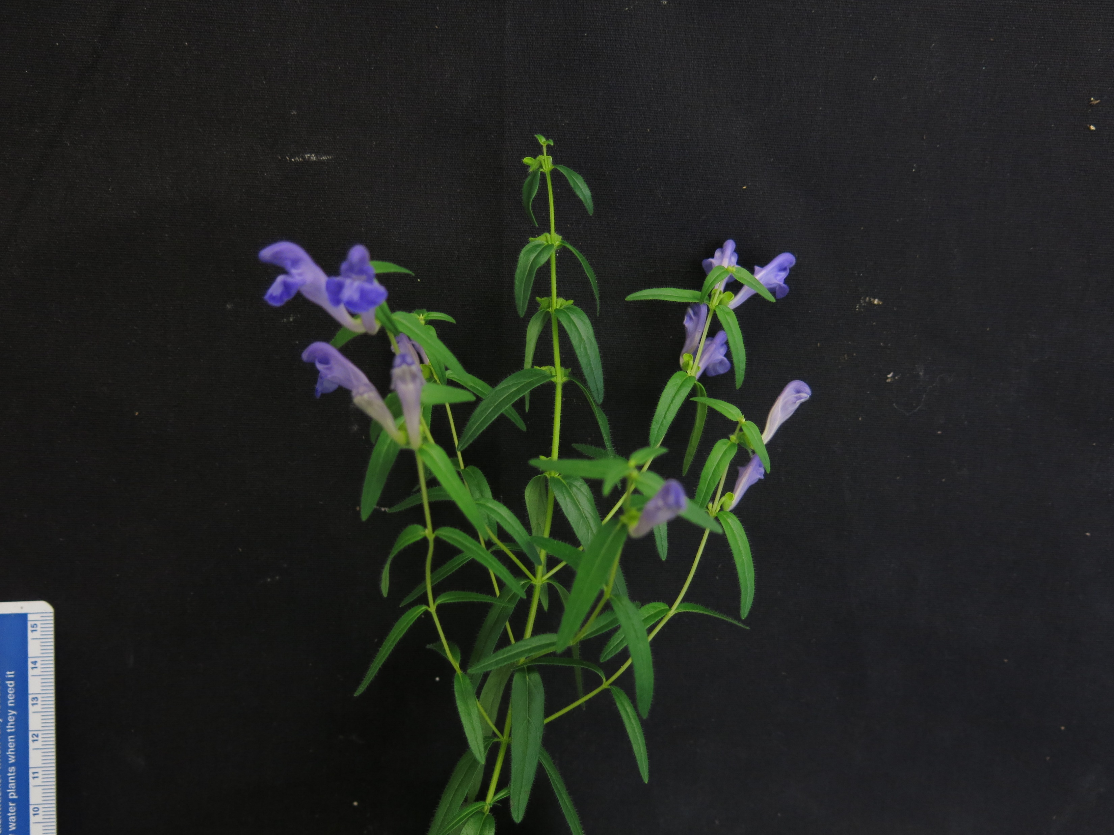
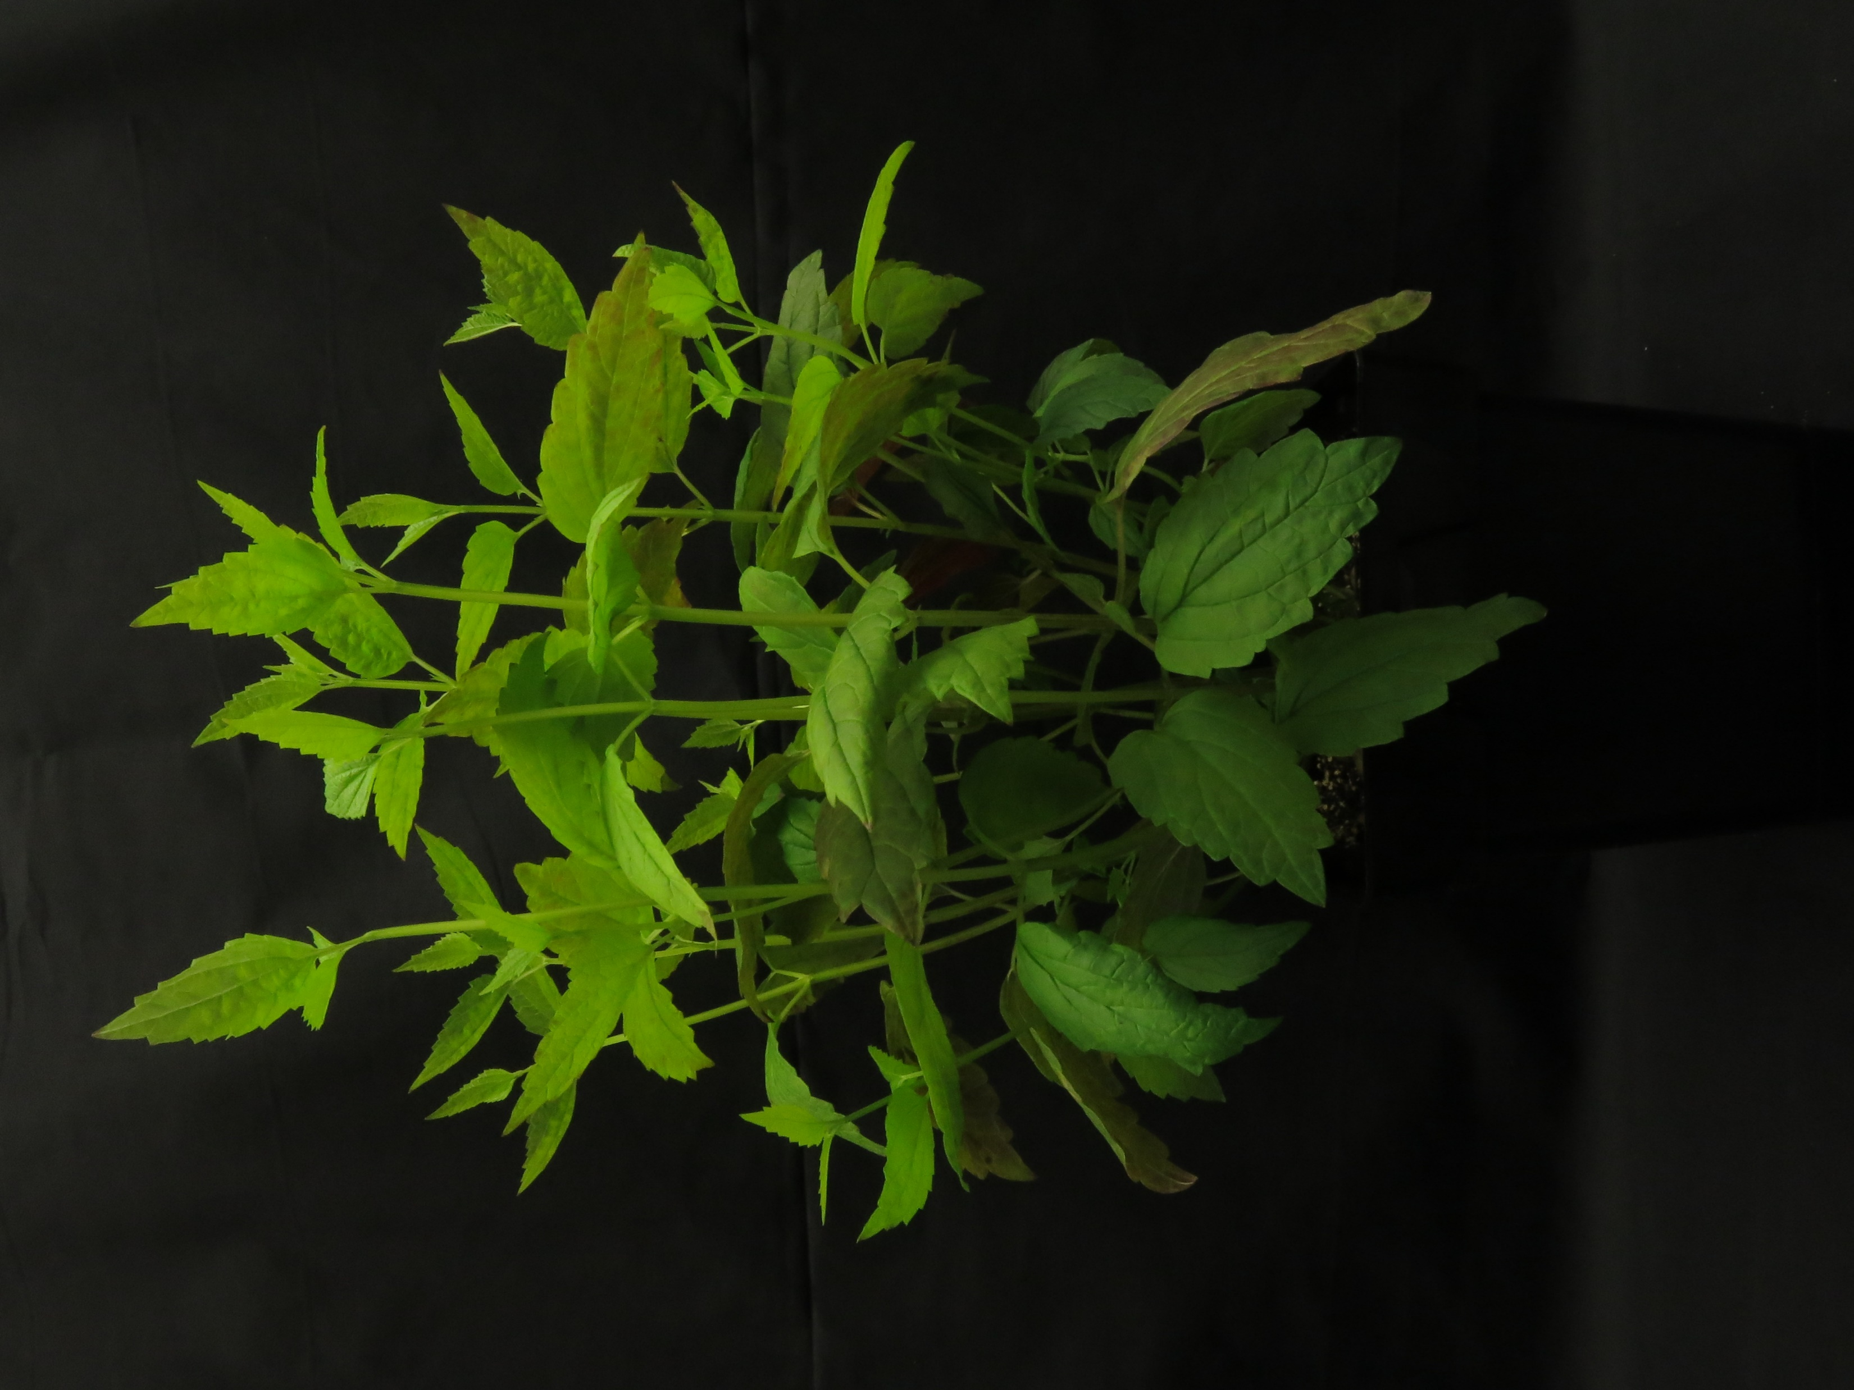
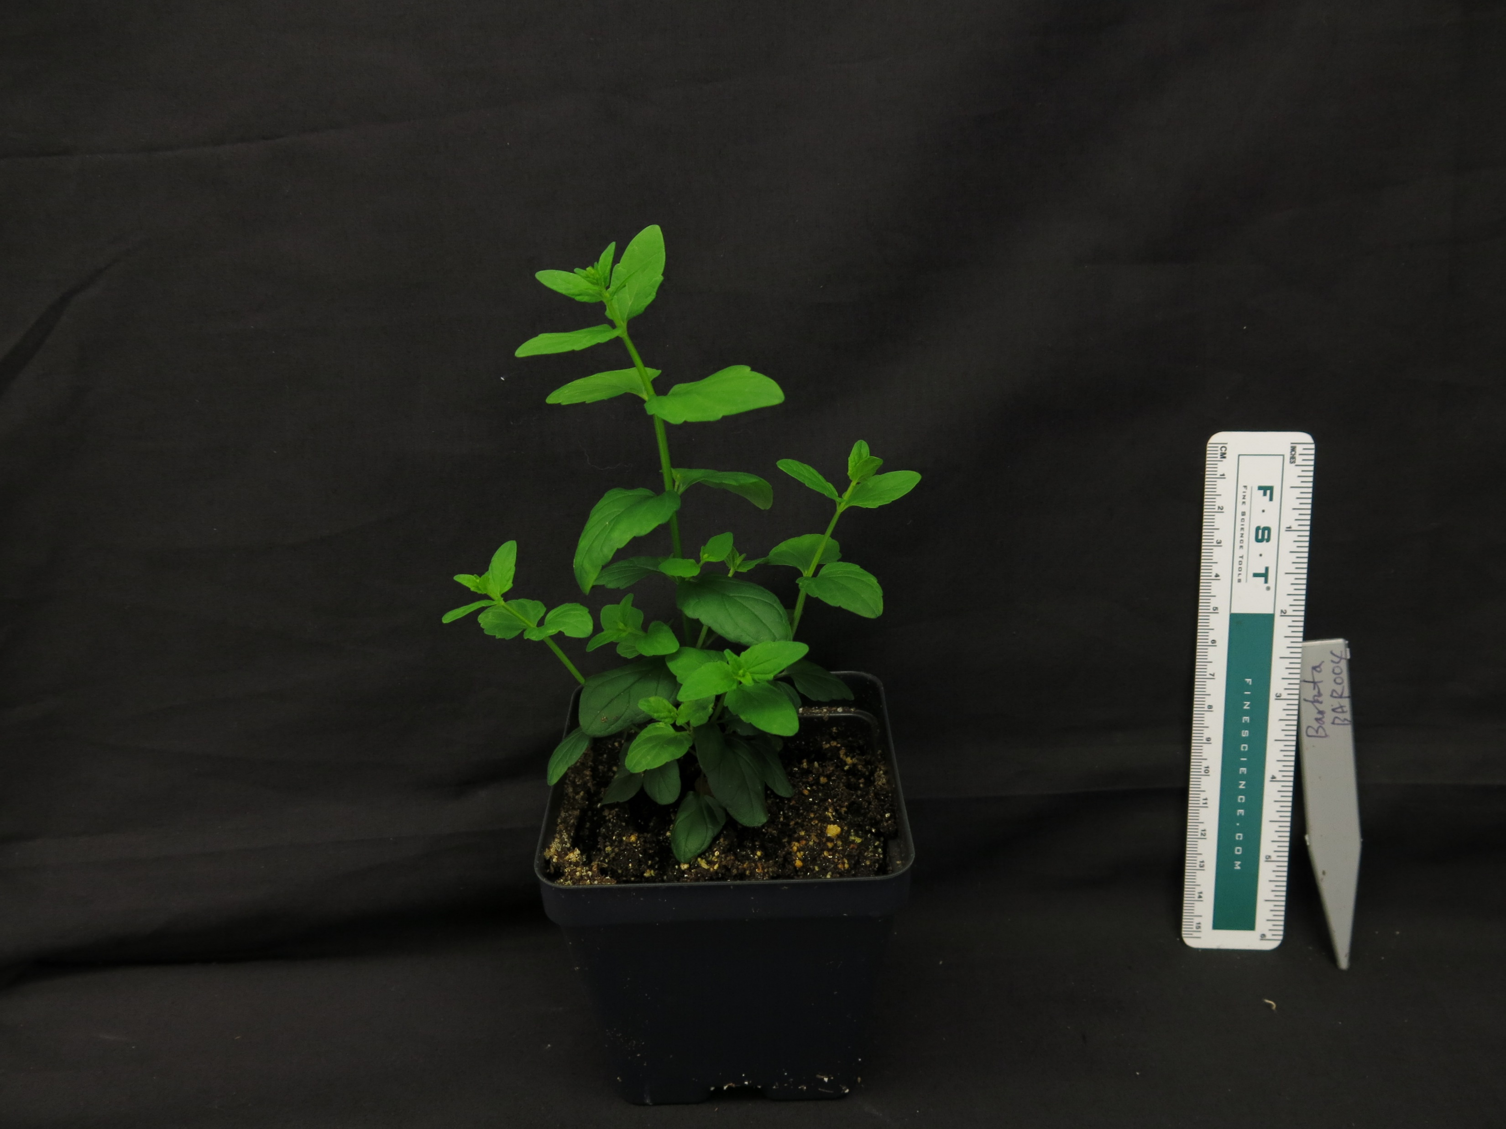
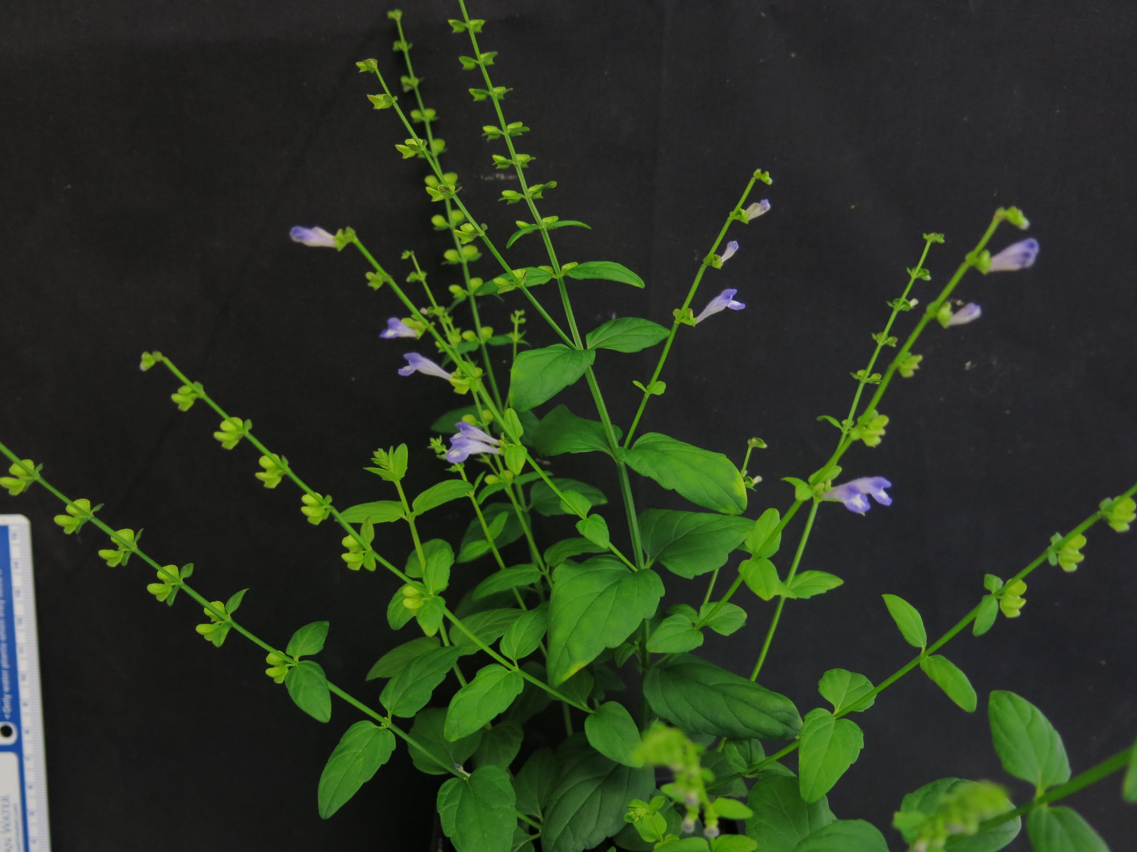
Introduction to the Scutellaria genus
Part of the Lamiaceae family
Rich in medicinal flavonoids (Shang et al., 2010)
Several species more well-studied because of their medicinal uses
S. baicalensis
Flavonoid | Medicinal use
Baicalein | Antitumor, hepatoprotective, & more
Wogonin | Anti-inflammatory, anxiolytic, & more
Oroxylin A | Neuroprotective, & anti-RSV
Scutellarein | Anti-RSV
S. lateriflora
S. barbata

Slide 3
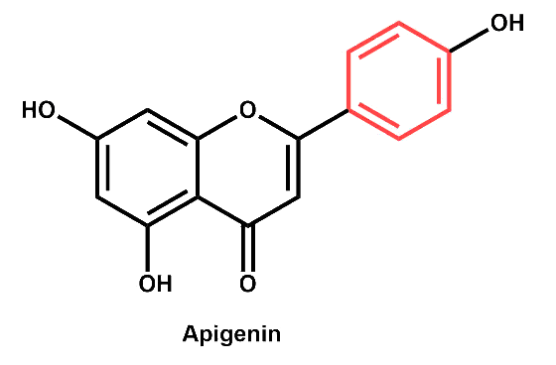
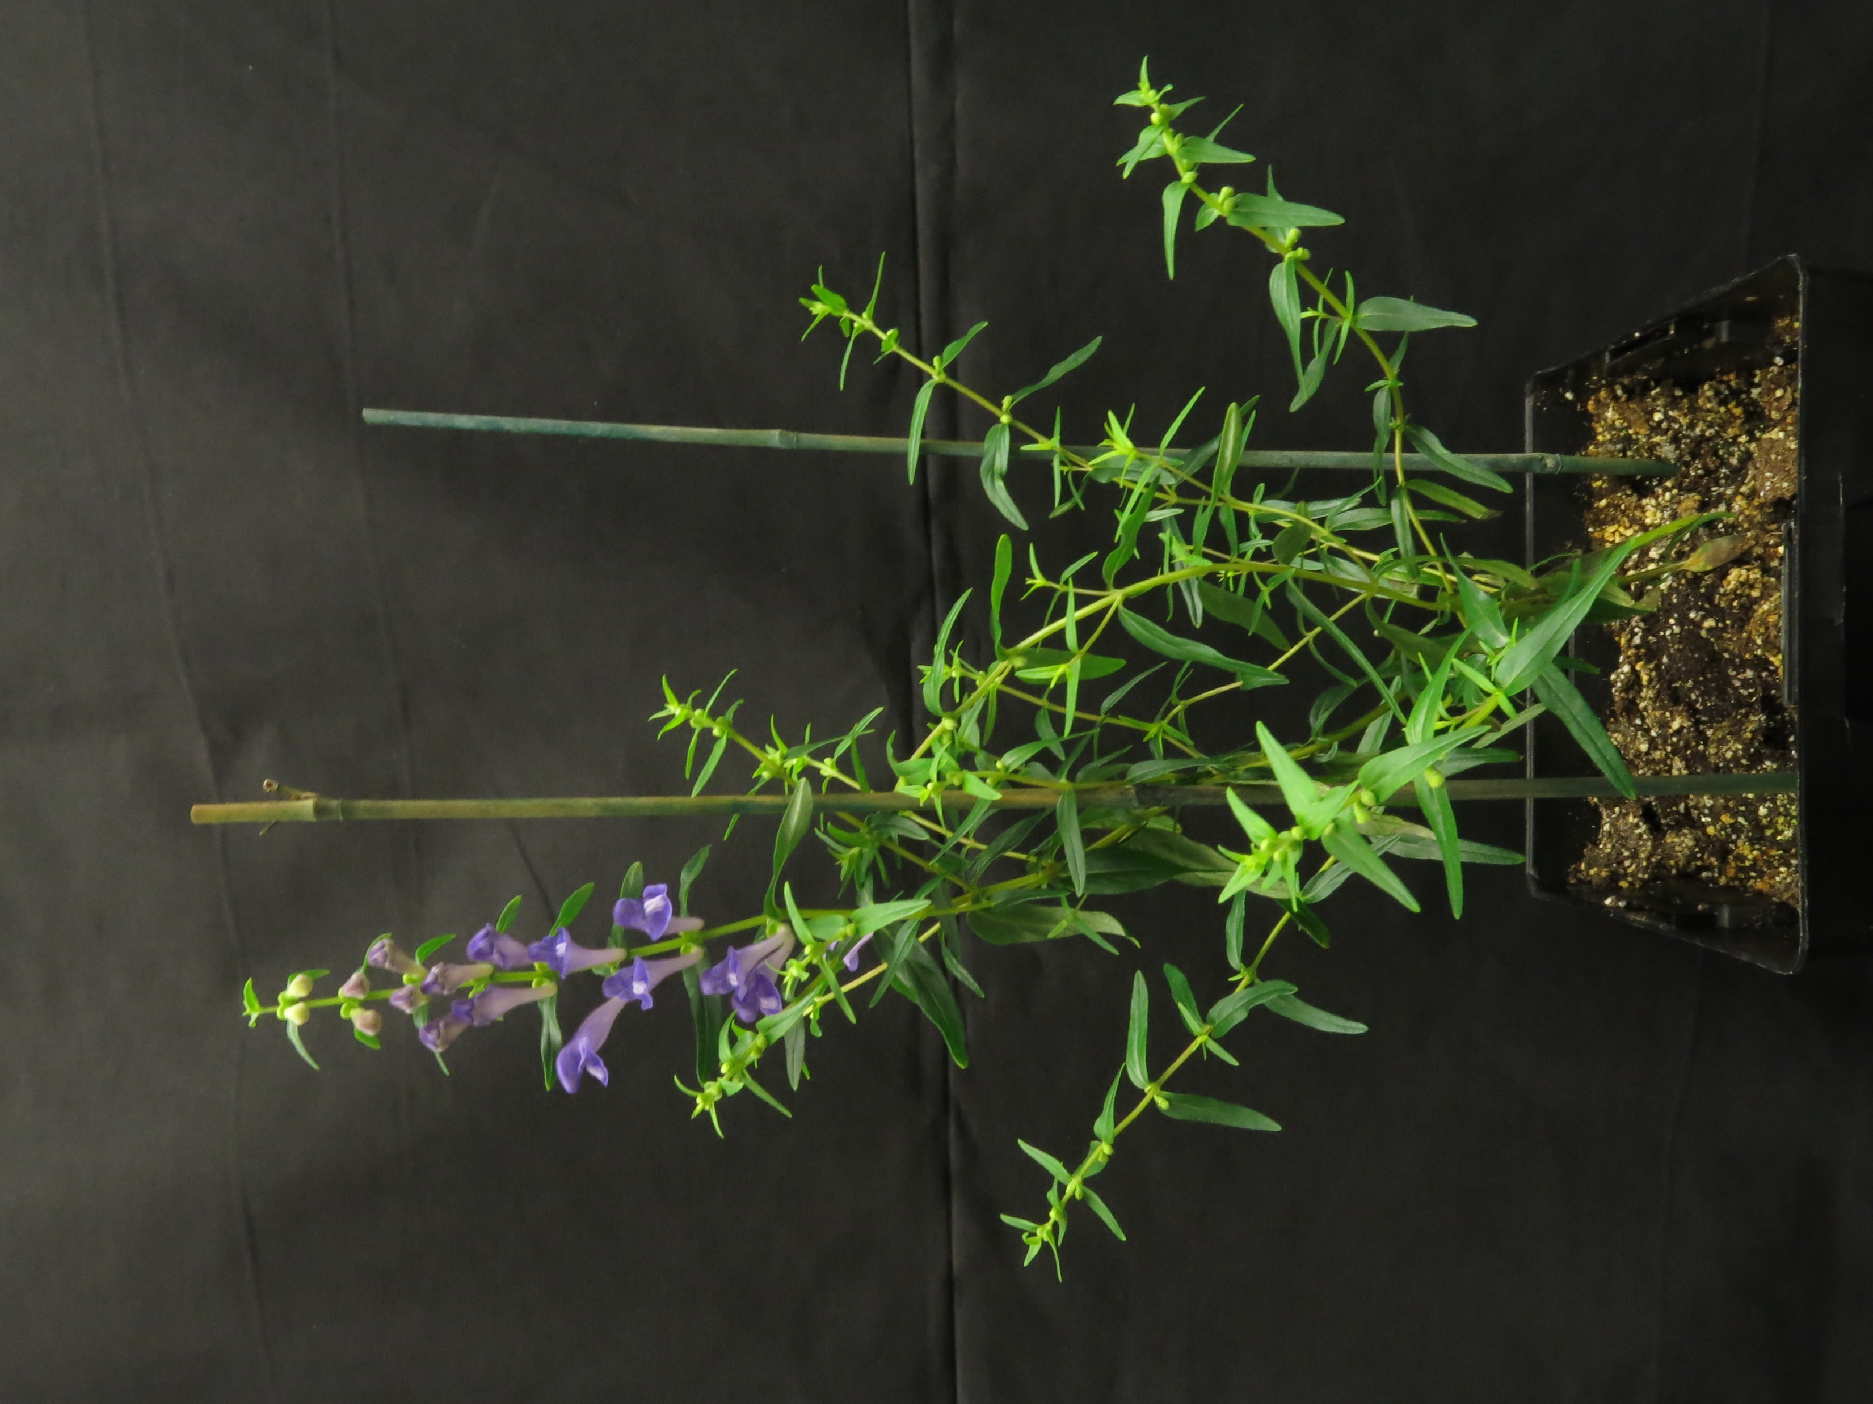
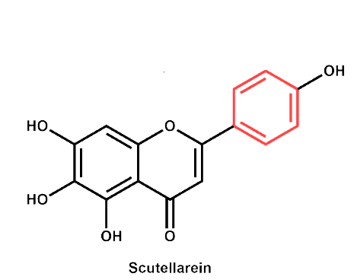
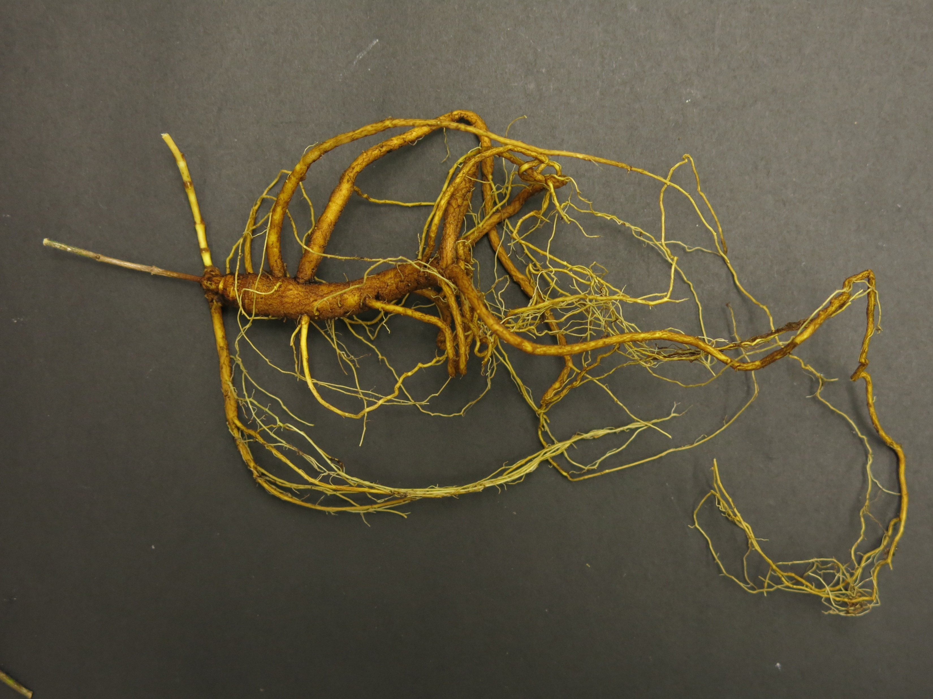
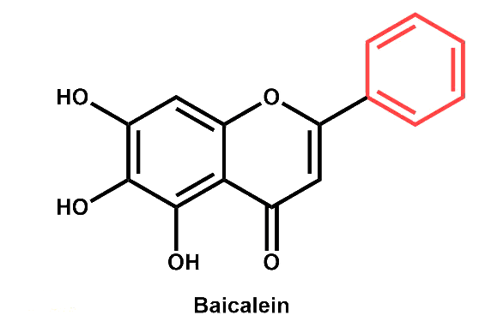
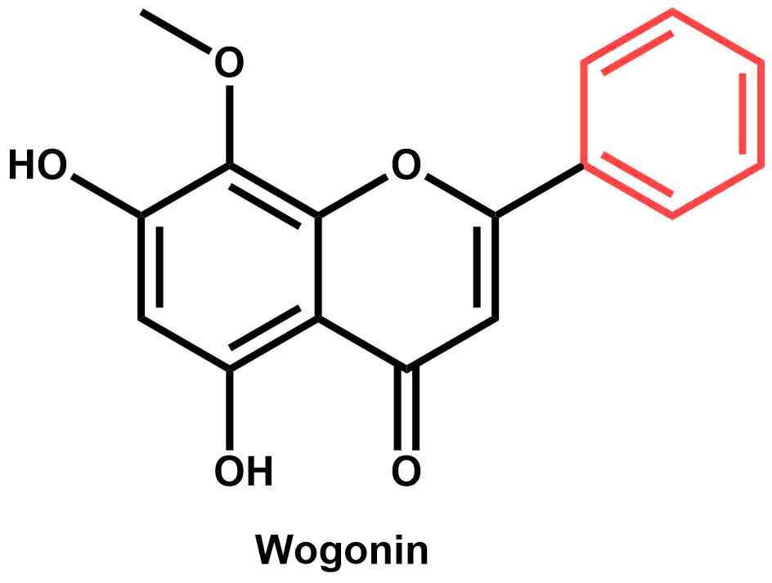
Scutellaria baicalensis
Apigenin
Most famous species
Used often in Chinese medicine – Huang Qin
Unique flavonoid profiles observed
Some specific to roots, and some to shoots
Organ-specific biosynthetic pathway proposed by Zhao et al. (2016)
Scutellarein
Baicalein
Wogonin

Slide 4



Scutellaria contains >470 species
Extent of flavonoid profile similarity is largely unknown
A better understanding of flavonoid diversity in Scutellaria would: |  | 1) Reveal interspecific differences in the underlying biosynthetic pathway
 |  | 2) Better characterize the evolutionary history of the biosynthetic pathway in the genus
 |  | 3) Help identify candidate species for biotechnology applications

Slide 5
Overview of method
Chemically assay a large set of Scutellaria species
Collect genome size data for a subset of species
Compare to phylogenetic data
Compare to phylogenetic data
Perform organ-specific chemical profiling on a subset of species
Compare to proposed biosynthetic pathway for S. baicalensis
Compare to phylogenetic data

Slide 6
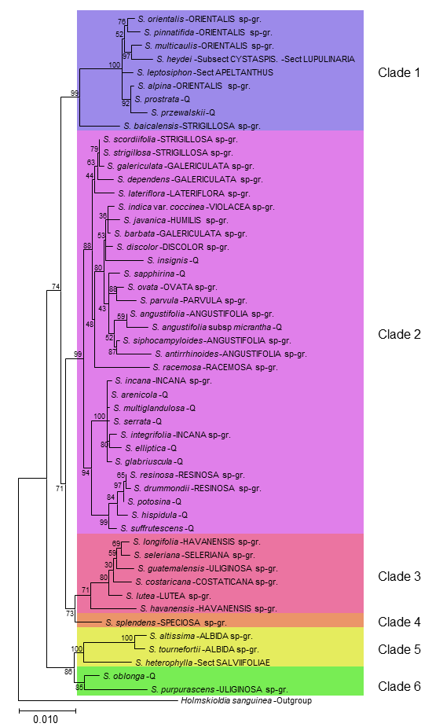
Phylogenetic tree
Constructed from chloroplast genomes of 52 species of Scutellaria
Species selected from both subgenera (Scutellaria and Apelthanthus)
22 out of 38 species-groups represented
Separated into 6 clades for downstream comparison

Slide 7
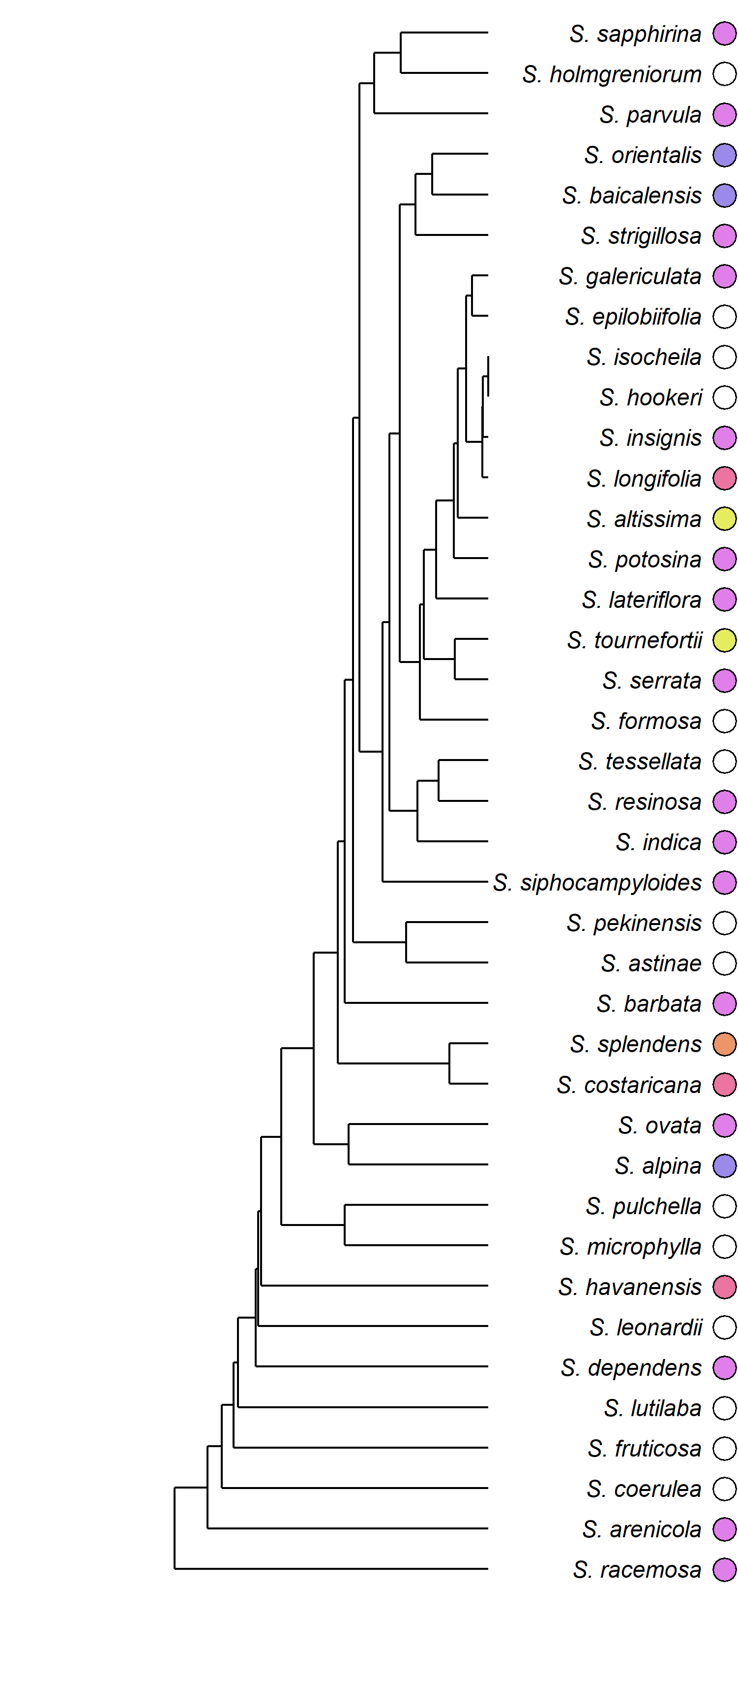
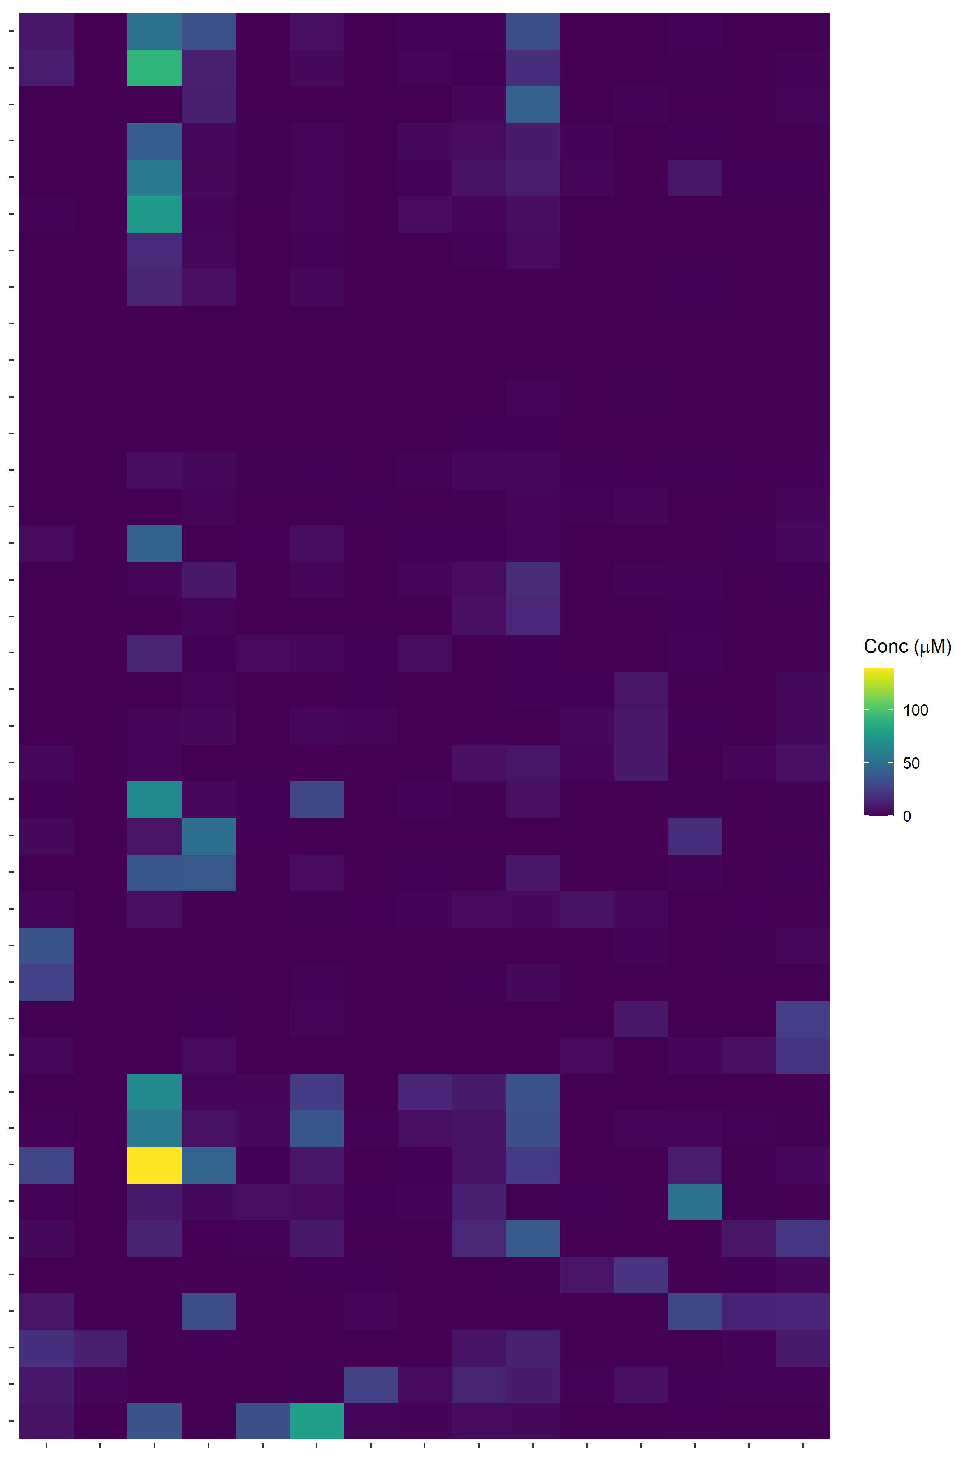
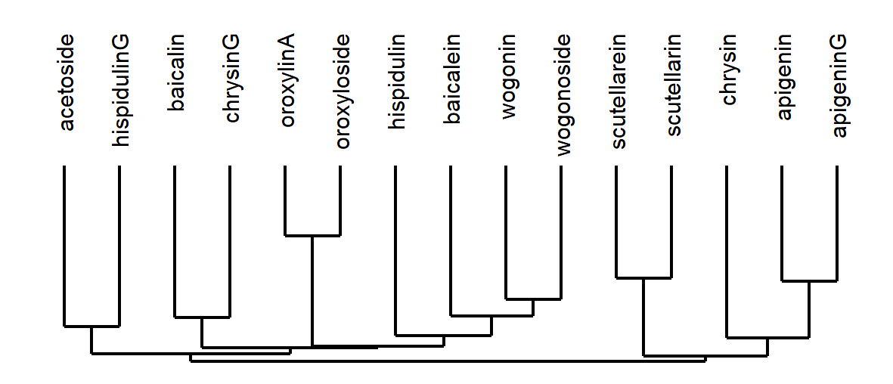
Chemical analysis
39 species selected for targeted profiling via HPLC
Order of species and flavonoids in heatmap determined by hierarchical clustering
Subset of species selected for organ-specific profiling

Slide 8
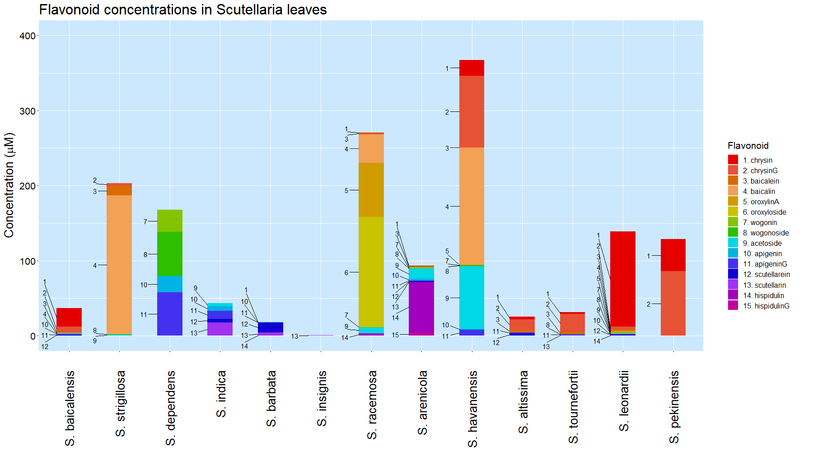

Slide 9
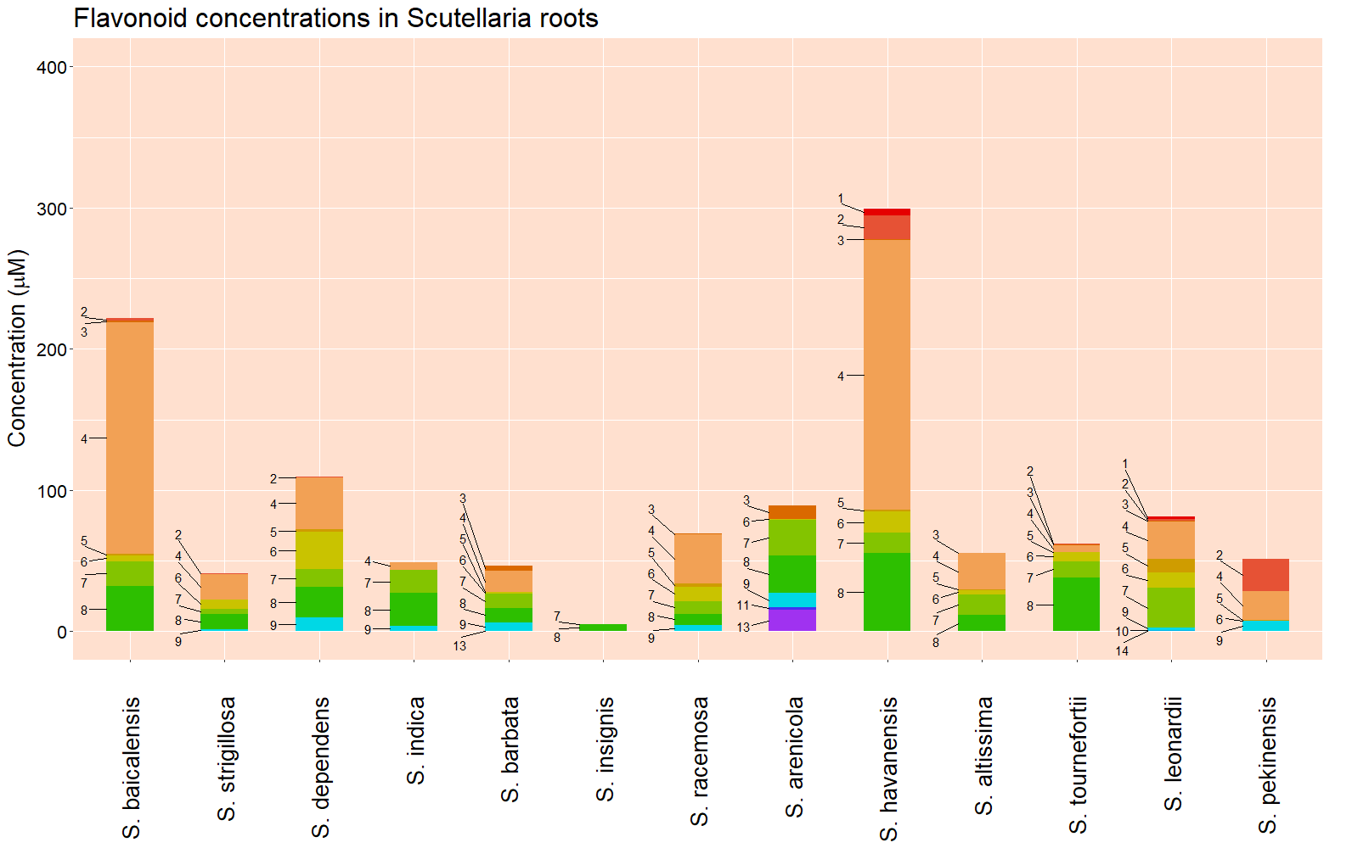

Slide 10
Proposed S. baicalensis biosynthetic pathway
Shoots
ApigeninG
Scutellarin
4-coumarate
Apigenin
Scutellarein
Hispidulin
HispidulinG
Phenylalanine
Cinnamic acid
Baicalin
Cinnamoyl-CoA
Chrysin
Baicalein
Oroxylin A
Oroxyloside A
ChrysinG
Norwogonin
Wogonin
Wogonoside
Roots
Adapted from Zhao et al. (2016)

Slide 11
Species | Estimated genome size (Gbp) |  | Chromosome number
 | Measured in this study | Published previously | Published previously
S. baicalensis | 0.54 | 0.38 (Xu et al., 2020) | 2n = 18 (Xu et al., 2020)
 |  | 0.41 (Zhao et al., 2019) | 2n = 18 (Zhao et al., 2019)
 |  | 0.41 (Cole et al., 2008)
S. strigillosa | n.d. | 0.38 (Lee & Kim, 2017)
S. dependens | 0.44
S. indica var. coccinea | n.d. | 0.38 (Lee & Kim, 2017)
S. barbata | 0.52 | 0.35 (Xu et al., 2020) | 2n = 26 (Xu et al., 2020)
S. insignis | n.d. | 0.46 (Lee & Kim, 2017)
S. racemosa | 0.44 | 0.37 (Cole et al., 2008) | 2n = 18 (Cole et al., 2008)
S. arenicola | 0.85
S. havanensis | 0.37
S. altissima | 0.39
S. tournefortii | 0.39
S. leonardii | 0.50
S. pekenensis | 0.38 | 0.45 (Lee & Kim, 2017)

Slide 12
Discussion
Diversity in flavonoid accumulation indicates differences in biosynthetic pathway
Several biotechnology targets identified
S. racemosa – high accumulation of oroxylinA and oroxyloside in aerial parts
S. havanensis – high accumulation of baicalin in both roots and aerial parts
S. arenicola – high accumulation of hispidulin in aerial parts
Only a slight correlation between phylogenetic clade and flavonoid profile was observed
Chloroplast genome may not be a good indicator of flavonoid diversification

Slide 13
Conclusion
Integrated chemical, phylogenetic, and genomic approach used to reveal differences in Scutellaria flavonoid production
Future work
Transcriptomic analysis to characterize genes controlling biosynthetic pathway
Genomics analysis to characterize differences in genome size and structure

Slide 14
References
Cole, I., Cao, J., Alan, A., Saxena, P., & Murch, S. (2008). Comparisons of Scutellaria baicalensis, Scutellaria lateriflora and Scutellaria racemosa: Genome Size, Antioxidant Potential and Phytochemistry. Planta Medica, 74(4), 474–481. https://doi.org/10.1055/s-2008-1034358
Lee, Y., & Kim, S. (2017). Genome size of 15 Lamiaceae taxa in Korea. Korean Journal of Plant Taxonomy, 47(2), 161–169. https://doi.org/10.11110/kjpt.2017.47.2.161
Shang, X., He, X., He, X., Li, M., Zhang, R., Fan, P., Zhang, Q., & Jia, Z. (2010). The genus Scutellaria an ethnopharmacological and phytochemical review. Journal of Ethnopharmacology, 128(2), 279–313. https://doi.org/10.1016/j.jep.2010.01.006
Xu, Z., Gao, R., Pu, X., Xu, R., Wang, J., Zheng, S., Zeng, Y., He, C., & Song, J. (2020). Comparative Genome Analysis of Scutellaria baicalensis and Scutellaria barbata Reveals the Evolution of Active Flavonoid Biosynthesis. BioRxiv Preprint. https://doi.org/10.1101/2020.02.18.954164
Zhao, Q., Yang, J., Cui, M.-Y., Liu, J., Fang, Y., Yan, M., Qiu, W., Shang, H., Xu, Z., Yidiresi, R., Weng, J.-K., Pluskal, T., Vigouroux, M., Steuernagel, B., Wei, Y., Yang, L., Hu, Y., Chen, X.-Y., & Martin, C. (2019). The Reference Genome Sequence of Scutellaria baicalensis Provides Insights into the Evolution of Wogonin Biosynthesis. Molecular Plant, 12(7), 935–950. https://doi.org/10.1016/j.molp.2019.04.002
Zhao, Q., Zhang, Y., Wang, G., Hill, L., Weng, J.-K., Chen, X.-Y., Xue, H., & Martin, C. (2016). A specialized flavone biosynthetic pathway has evolved in the medicinal plant, Scutellaria baicalensis. Science Advances, 2(4), e1501780. https://doi.org/10.1126/sciadv.1501780

Slide 15
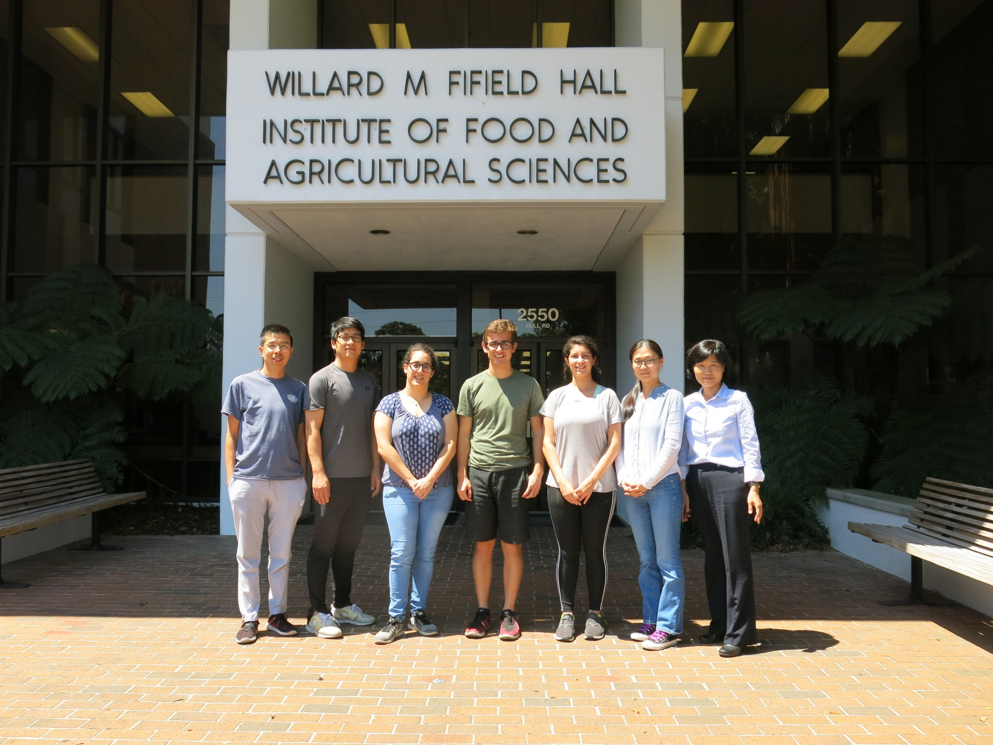


Acknowledgements
Thanks to Dr. Jeongim Kim and Ru Dai for helping with my HPLC analyses and watering my plants when I could not.
Move coauthors here
This work was supported by funding from:
National Research Foundation of Korea (NRF 2017R1D1A1B03034952)
NIFA HATCH Project #005681

